Slide 1
Some old baselines; Abandoned
Up to now, adversarial methods don’t work with multi tasks(3D Semseg + 3D detection)

Slide 2
Multi-modal Multi-Task fusion
Train/test dataset | Usa/sng | Sng/sng | Day/night | Night/night
Segmentation (mIoU) | 60.69 | 73.47 | 43.67 | 42.24
Detection (mAP) | 51.29 | 68.42 | 52.53 | 40.73
Multi-modal Mutli-task fusion; det supervise seg(Usa/Sng)
Target loss weight | 1.0 | 0.1 | 0.01 | 0.001 | 0.0001 | 0.1 | 0.01
ignore background | F | F | F | F | F | T | T
Segmentation (mIoU) | 27.97 | 27.36 | 39.15 | 58.84 | 59.82 | 19.98 | 21.02
Detection (mAP) | 32.61 | 39.04 | 44.56 | 51.66 | 51.89 | 43.20 | 39.47
Adversarial(Discriminate on the last img feature map)
Train/test | Usa/sng | Day/night
Segmentation (mIoU) | 59.65 | 46.26
Detection (mAP) | 49.39 | 51.60

Slide 3
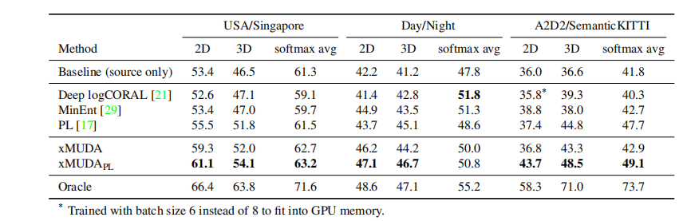
Train dataset | train_usa |  | train_day
Test dataset | test_usa | test_singapore | test_day | test_night
2D | 66.03 | 54.03 | 70.27 | 38.81
3D | 55.03 | 48.41 | 60.51 | 43.75
2D+3D | 69.12 | 62.10 | 75.56 | 48.63
Train dataset | train_usa |  | train_day
Test dataset | test_usa | test_singapore | test_day | test_night
2D |  | 57.04 |  | 49.62
3D |  | 53.57 |  | 45.55
2D+3D |  | 62.53 |  | 52.99
baseline
xMuda: KLdiv + target
Train dataset | train_usa |  | train_day
Test dataset | test_usa | test_singapore | test_day | test_night
Segmetation (overall_IoU) | 71.76 | 60.27 | 76.00 | 45.45
Detection (mAP) | 68.79 | 50.21 | 73.45 | 51.97
Fusion; with 2D aug & class_weights
old label
Train dataset | train_usa |  | train_day
Test dataset | test_usa | test_singapore | test_day | test_night
Segmetation (overall_IoU) | 59.07 | 50.80 | 65.11 | 41.28
Detection (mAP) | 65.18 | 33.22 | 63.48 | 49.32
Separate; with 2D aug & class_weights

Slide 4
Trash

Slide 5
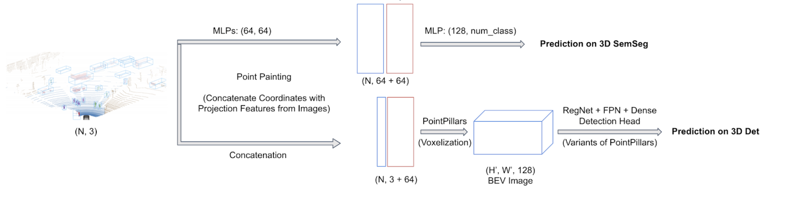
Multi-modal Multi-Task fusion(Usa-sng)
Fusion | Multi-Task | Semseg(mIoU) | 3D Det(mAP)
 |  | 50.80 | 33.22
√ |  | 53.03
√ | √ | 60.69 | 51.29

Slide 6
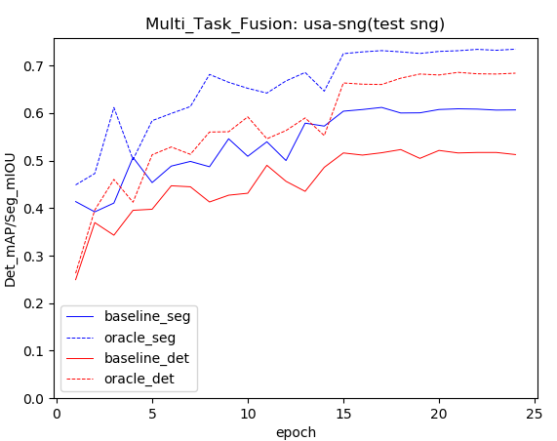
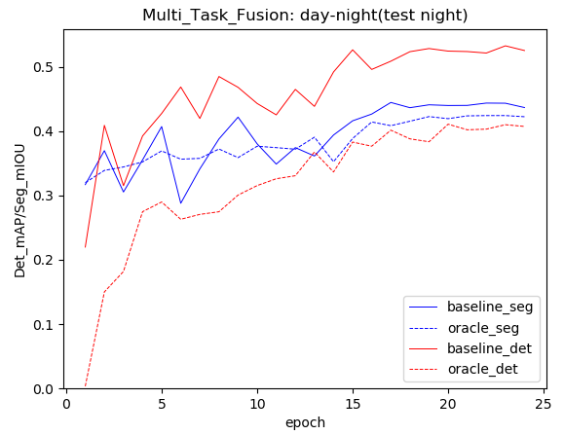
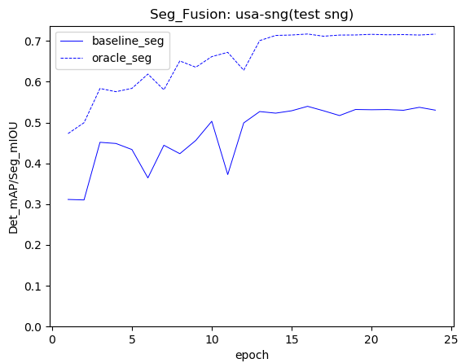
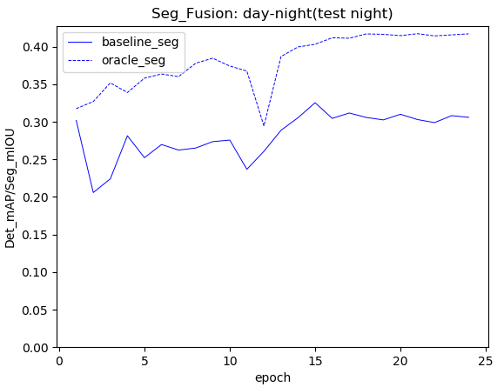

Slide 7
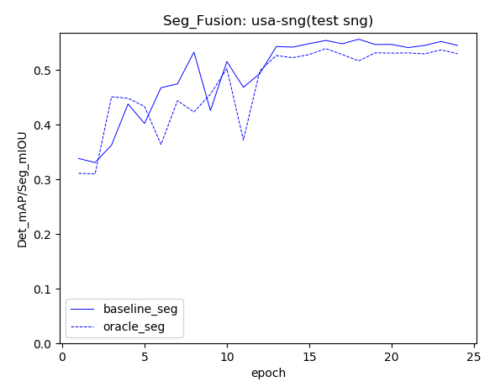

Slide 8
Use points inside 3D pred boxes to supervise 3D Semseg;
Doesn’t work regardless of ignore_background=True or False.

Slide 9
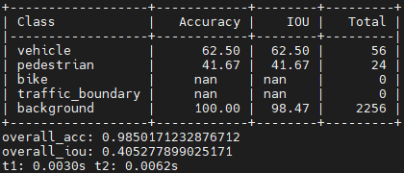
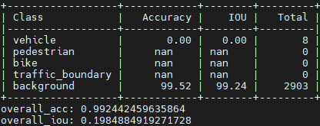
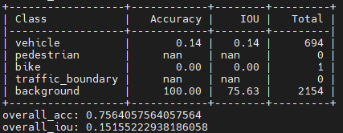
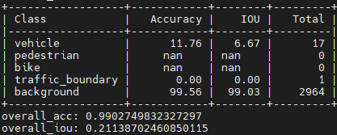
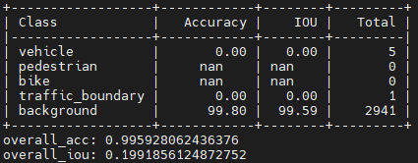
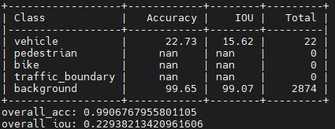
Total: num_real_label

Slide 10
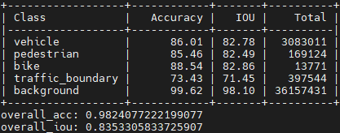
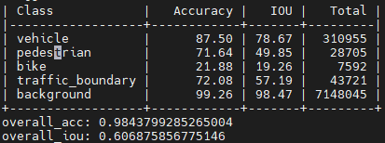
train usa: gt_seg vs pts in gt_box
fusion_usa_rep_new: baseline

Slide 11
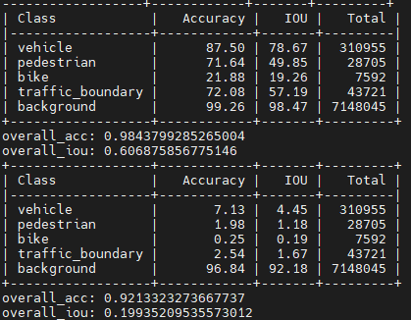
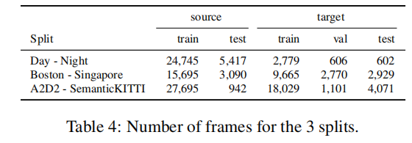
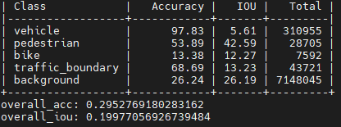
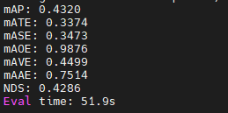
usa-sng
Baseline on target: pred_seg vs pts_in_pred_box
- src_task_loss
Source: pts_in_gt_box
Train_usa_test_sng:
- src_task_loss+target_seg_loss_no_bg

Slide 12
Det:[45.56, 47.10, 46.88, 39.27, 44.31, 42.49, 49.68, 47.73, 48.58, 49.48, 43.68, 50.71, 50.12, 50.76, 51.26, 50.26, 50.89, 50.55, 50.21]
Seg:[54.42, 57.09, 53.51, 35.79, 57.43, 54.98, 59.87, 56.13, 54.80, 58.67, 49.16, 58.43, 59.59, 59.99, 60.22, 59.68, 60.57, 60.39, 60.27]

Slide 13
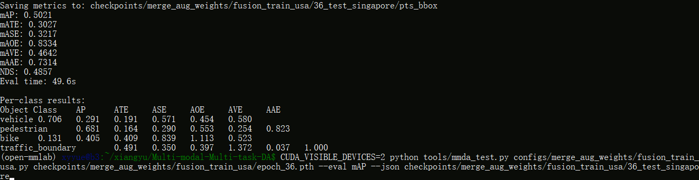
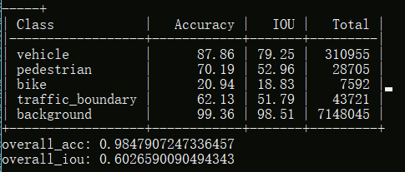

Slide 14
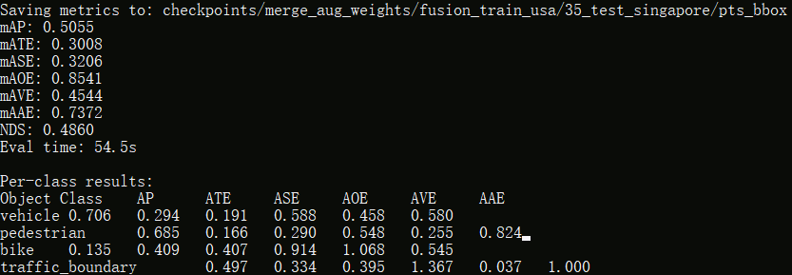
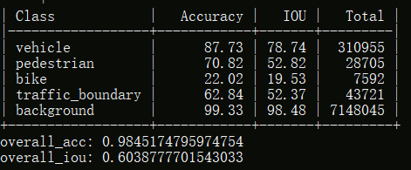
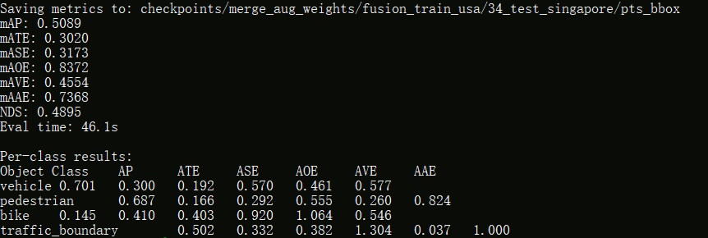
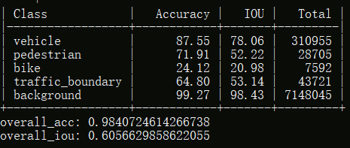

Slide 15
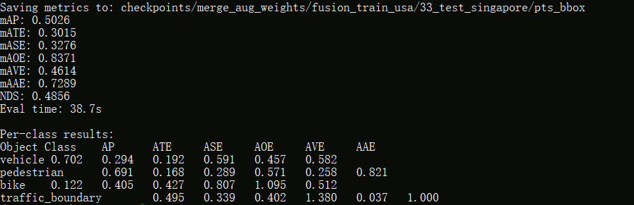
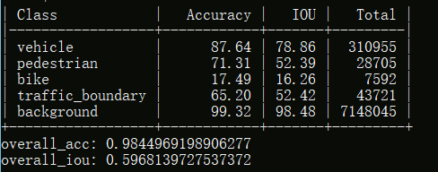
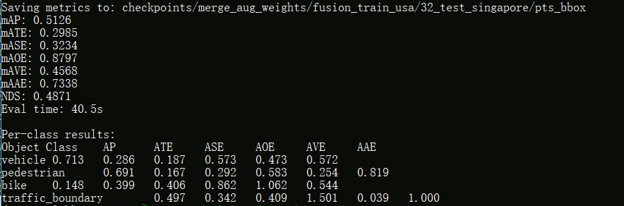
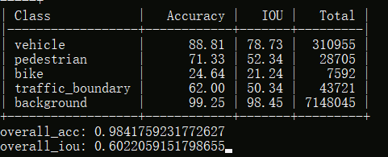

Slide 16
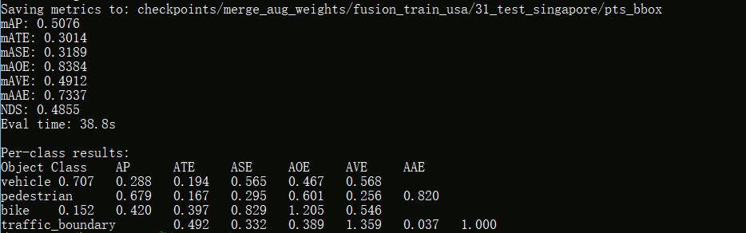
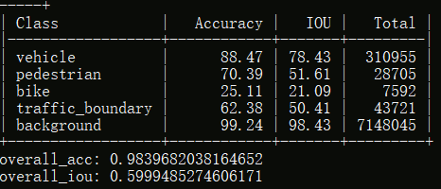
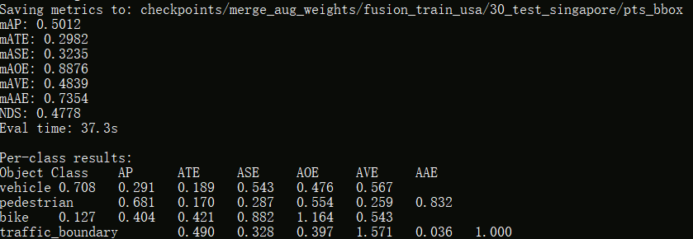
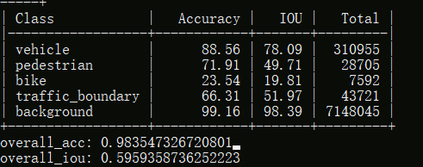

Slide 17
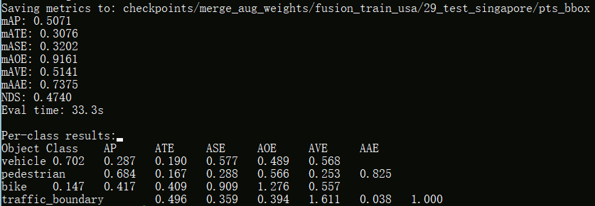
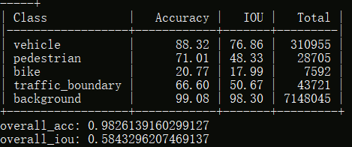

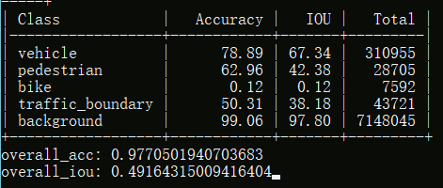

Slide 18
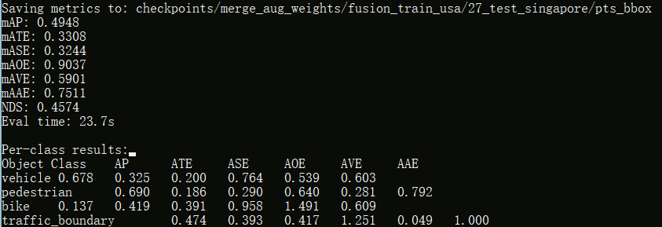
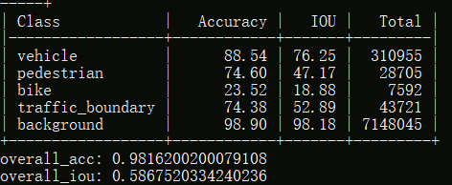
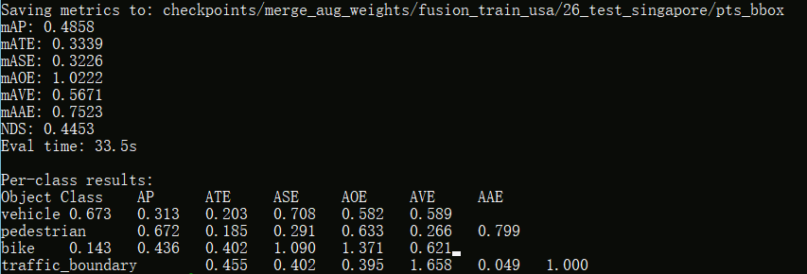
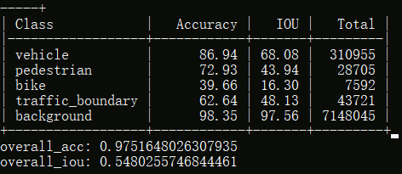

Slide 19
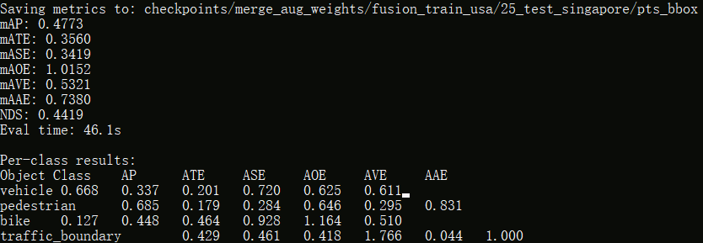
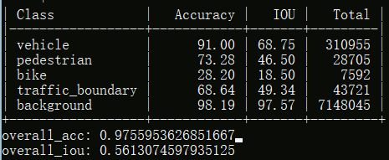
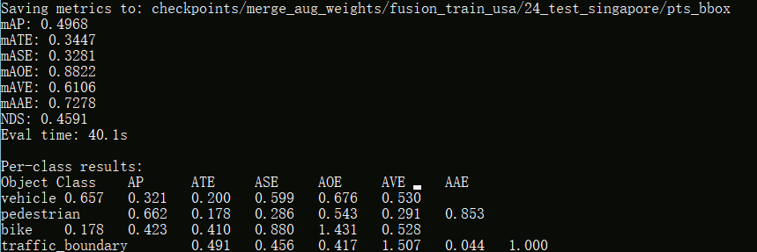
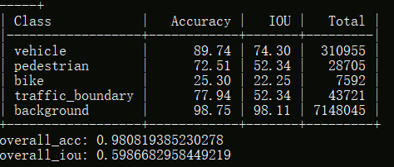

Slide 20
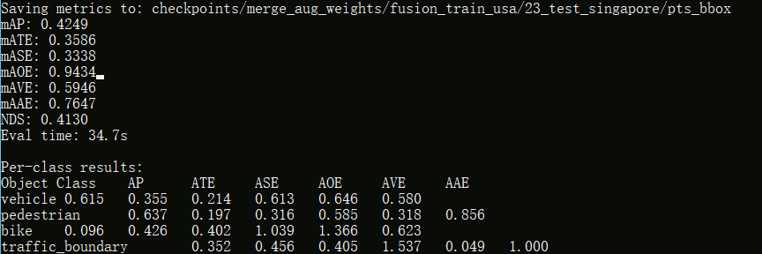
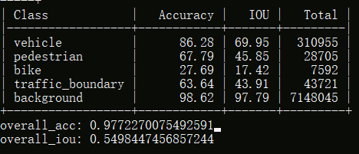
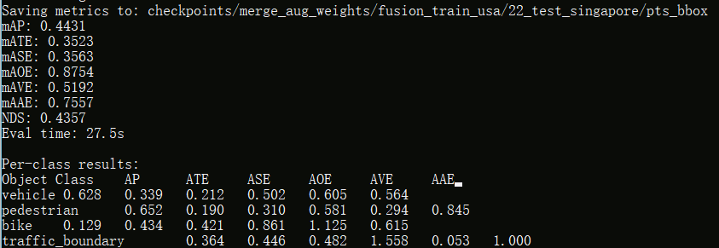
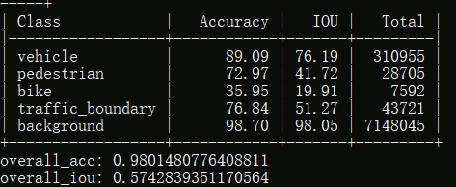

Slide 21

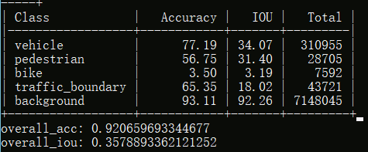

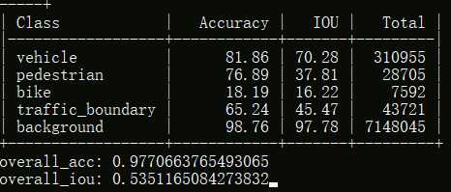

Slide 22





Slide 23
[19, 36]
Seg:[42.79, 41.23, 41.07, 43.18, 40.86, 44.47, 45.13, 41.12, 40.57, 43.80, 45.09, 45.50, 45.66, 45.70, 45.16, 45.58, 45.09, 45.45]
Det:[45.69, 43.37, 41.17, 46.89, 45.11, 53.15, 47.38, 50.23, 48.75, 49.15, 49.85, 48.08, 48.96, 49.60, 51.00, 51.65, 51.56, 51.97]

Slide 24





Slide 25





Slide 26





Slide 27





Slide 28





Slide 29





Slide 30





Slide 31





Slide 32





Slide 33
Separate; with 2D aug & class_weights; epoch_36
Train dataset | train_usa |  | train_day
Test dataset | test_usa | test_singapore | test_day | test_night
Segmetation (overall_IoU) | 59.07 | 50.80 | 65.11 | 41.28
Detection (mAP) | 65.18 | 33.22 | 63.48 | 49.32
4 classes + background
vehicle (car, truck, bus, trailer, construction_vehicle)
pedestrian,
bike (motorcycle, bicycle),
traffic_boundary (traffic_cone, barrier)

Slide 34




Slide 35




Slide 36




Slide 37




Slide 38
Fusion; with 2D aug & class_weights; epoch_36
Train dataset | train_usa |  | train_day
Test dataset | test_usa | test_singapore | test_day | test_night
Segmetation (overall_IoU) | 71.76 | 60.27 | 76.00 | 45.45
Detection (mAP) | 68.79 | 50.21 | 73.45 | 51.97
4 classes + background
vehicle (car, truck, bus, trailer, construction_vehicle)
pedestrian,
bike (motorcycle, bicycle),
traffic_boundary (traffic_cone, barrier)

Slide 39




Slide 40




Slide 41




Slide 42


Slide 43
xMuda: xmuda, KL divergence
Differences:
test target with best validation
num_points(cone vs triangle(rectangle & cone))
Train dataset | train_usa |  | train_day
Test dataset | test_usa | test_singapore | test_day | test_night
2D |  | 57.04 |  | 49.62
3D |  | 53.56 |  | 45.55
2D+3D |  | 62.49 |  | 52.99
4 classes + background
vehicle (car, truck, bus, trailer, construction_vehicle)
pedestrian,
bike (motorcycle, bicycle),
traffic_boundary (traffic_cone, barrier)

Slide 44




Slide 45



Best val:
2d_035000
3d_095000

Slide 46
xMuda: baseline, without KL divergence
Differences:
2D aug & class_weights
test target with best target validation
test source with last checkpoint
num_points(cone vs triangle(rectangle & cone))
Train dataset | train_usa |  | train_day
Test dataset | test_usa | test_singapore | test_day | test_night
2D | 66.03 | 54.03 | 70.27 | 38.81
3D | 55.03 | 48.41 | 60.51 | 43.75
2D+3D | 69.12 | 62.10 | 75.56 | 48.63
4 classes + background
vehicle (car, truck, bus, trailer, construction_vehicle)
pedestrian,
bike (motorcycle, bicycle),
traffic_boundary (traffic_cone, barrier)

Slide 47




Slide 48


Slide 49




Slide 50


Slide 51
Separate; without 2D aug & class_weights
Train dataset | Nuscenes train | train_usa |  | train_day
Test dataset | Nuscenes val | test_usa | test_singapore | test_day | test_night
Segmetation (overall_IoU) | 66.62 | 61.36 | 31.64 | 67.01 | 27.79
Detection (mAP) | 64.01 | 66.25 | 33.21 | 63.43 | 43.51
4 classes + background
vehicle (car, truck, bus, trailer, construction_vehicle)
pedestrian,
bike (motorcycle, bicycle),
traffic_boundary (traffic_cone, barrier)

Slide 52




Slide 53




Slide 54




Slide 55



Slide 56



Slide 57
Fusion, without 2D aug & class_weights
Train dataset | Nuscenes train | train_usa |  | train_day
Test dataset | Nuscenes val | test_usa | test_singapore | test_day | test_night
Segmetation (overall_IoU) | 73.82 | 67.16 | 50.78 | 73.96 | 36.27
Detection (mAP) | 72.15 | 71.12 | 46.60 | 71.79 | 49.25
4 classes + background
vehicle (car, truck, bus, trailer, construction_vehicle)
pedestrian,
bike (motorcycle, bicycle),
traffic_boundary (traffic_cone, barrier)
Todo: Without fusion
Xmuda: new seg label(baseline, KL div)

Slide 58



Slide 59



Slide 60



Slide 61



Slide 62



Slide 63



Slide 64
10 classes + background; without 2D aug & class_weights
Train dataset | Nuscenes train(fusion) | Nuscenes train(No fusion) | train_usa(fusion) |  | train_day(fusion)
Test dataset | Nuscenes val | Nuscenes val | test_usa | test_singapore | test_day | test_night
Segmetation (overall_IoU) | 60.8 | 54.4 | 54.7 | 33.1 | 61.2 | 17.7
Detection (mAP) | 54.7 | 47.1 | 52.8 | 29.3 | 54.0 | 20.0

Slide 65



single img segmentation
single lidar detection

Slide 66


Img_seg_head after fusion: 68, 34, num_classes

Slide 67


old validation: 为什么缺了一个barrier(0.538那个倒是没缺)

Slide 68




Slide 69



Slide 70



Slide 71




Slide 72


train_usa, test_usa

Slide 73


train_usa, test_singapore

Slide 74


train_day, test_day

Slide 75


train_day, test_night

Slide 76
Old network structures

Slide 77


Conv2d encoder
denser depth image
Segmentation Map
concat
decoder
RGB image
pix2pix:
make lidar points denser
by translation
sparse fusion
Classifier
Backbone
Conv2d
Pointpillars:
Voxel feature extractor
detection head
Box Regressor
H
Direction
Classifier
Lidar point cloud
H
W
W
C

Slide 78

Classifier
(N, num_class* num_anchor_pre_class, H, W)
C=256, H, W
Box Regressor
(N, num_class* num_anchor_pre_class * 7, H, W)
⊕
point_cloud_range = [-50, 0, -5, 50, 50, 3]
voxel_size = [0.25, 0.25, 8]
upsample
C=256, H, W
Direction
Classifier
(N, num_class* num_anchor_pre_class * 2, H, W)
⊕
Pointpillars:
Voxel feature extractor
C=64
upsample
C=256, H, W
200
100
50
25
400
200
100
50
Lidar point cloud
200
400

Slide 79
Img
200, 400

Slide 80
(N, 64+64)
MLP
Fc:(128, num_class)
F_2D=64
(64, H, W)
voxelization
(N, 3)
(64, H, W)
detector
backbone
voxelization
concat
(128, H, W)

Slide 81
(N, 64+4)
MLP
Fc:(68, num_class)
F_2D=64
concat
BEV: (128, H, W)
(N, 4)
(N, 68)
detector
backbone
voxelization

